Slide 1

Immigration AI Advisor
Team: Borderless.AI Sprint 0 Presentation
Notes:
Miles

Slide 2

Agenda
Team Member Roles and Responsibilities
Problem Statement
Project Description
Personas
Technologies
Algorithms
Project Schedule
Team Working Agreement
Retrospective
Notes:
Miles

Slide 3
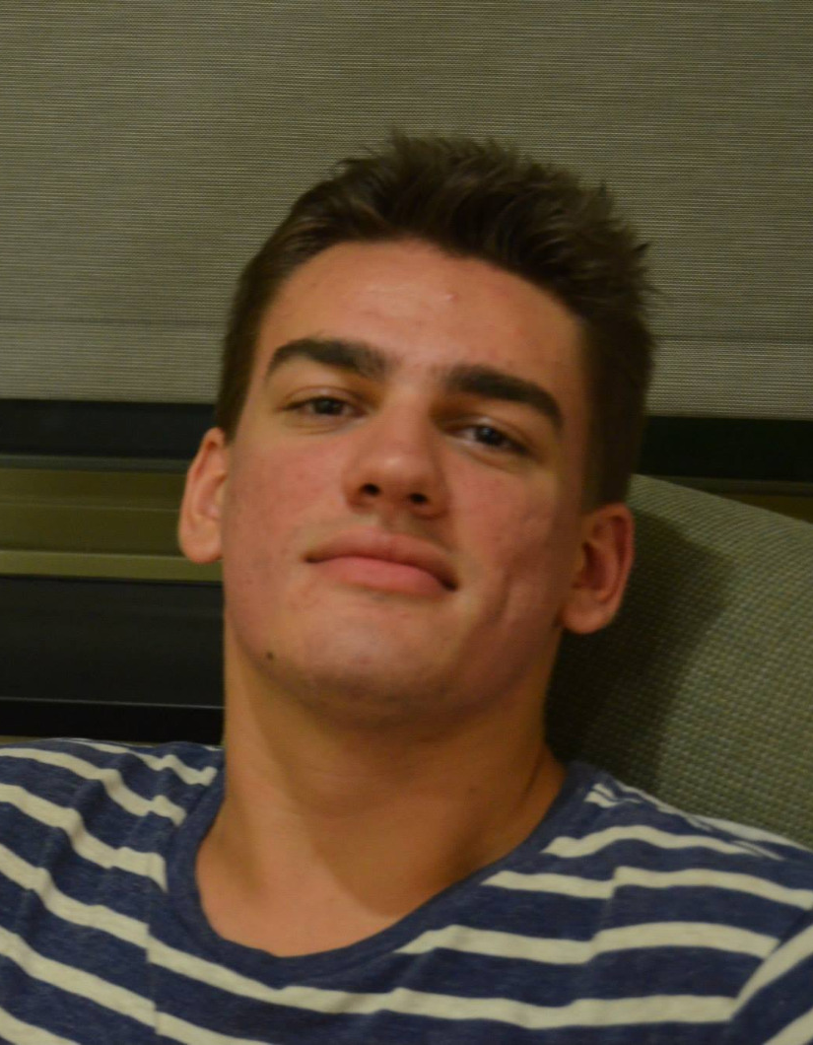
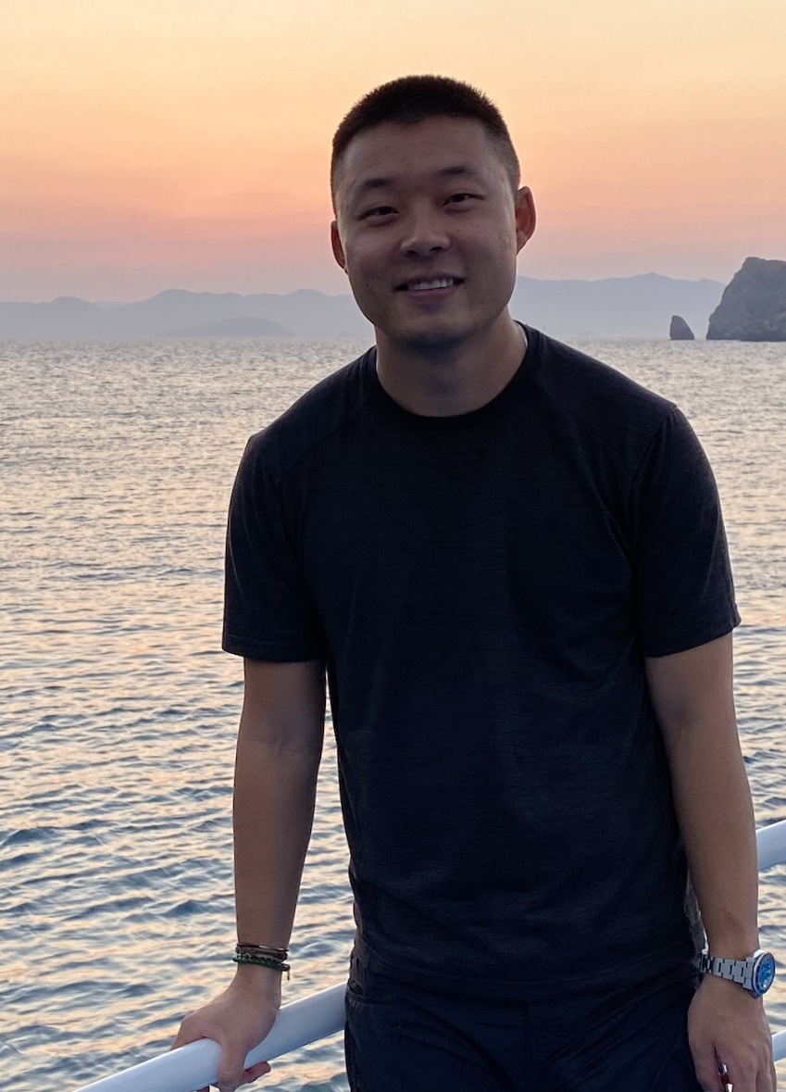
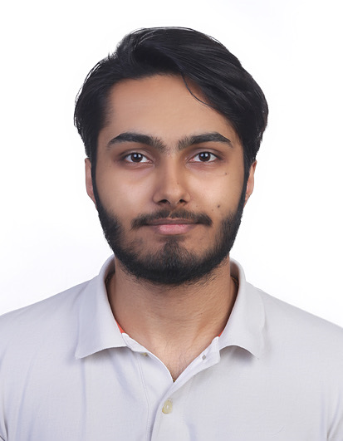

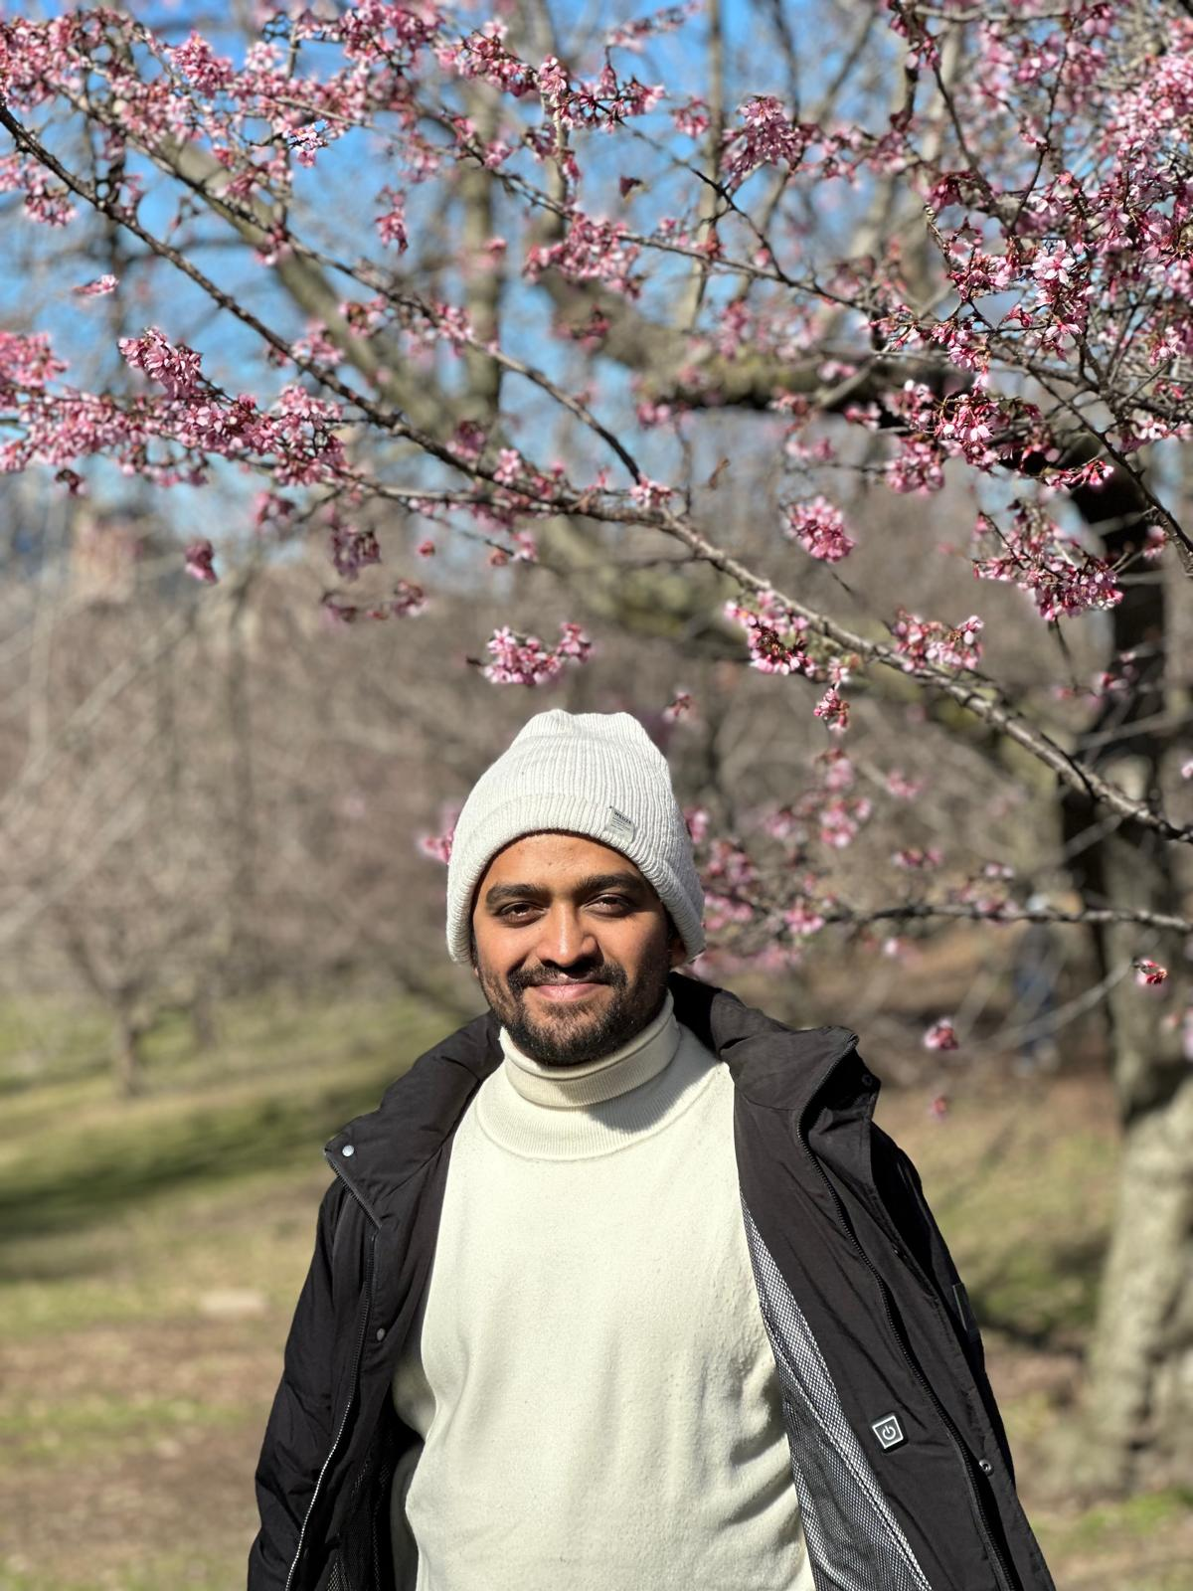
Team Member Roles and Responsibilities
Matt Borkowski
Developer
SCRUM Master
Miles ZhengFerrari
Developer
Team Leader
Nuvorish Paul
Developer
Raj Rahul Parekh
Developer
Santhosh Charudatta
Developer
All team members collaborate as developers, contributing to coding, testing, and feature development.
Notes:
Matt

Slide 4
Problem Statement
The Challenge:
International students often face complex and time-sensitive immigration-related questions, and existing processes for getting accurate advice are slow. Many higher education institutions, particularly their international student offices, are under-resourced and operate on tight budgets, leaving advisers overworked and unable to keep up with growing demand. This results in delays and a frustrating experience for students seeking immediate immigration guidance.
Notes:
Raj

Slide 5
Problem Statement
Hypothesis:
If we provide an AI-based tool that reads immigration documents and cross-references them with the latest regulations, we can offer faster, more accurate advice to international students. This would not only improve their experience but also ease the burden on student advisers, allowing institutions to better manage their limited resources and operate more efficiently within budget constraints.
Notes:
Raj

Slide 6
Project Description
Project Name: Immigration AI Advisor
Team: Borderless.AI
Project Description:
Immigration AI Advisor is a AI-based application designed to assist international students with immigration-related queries by reading documents (I-20, I-94) and providing personalized advice based on immigration rules and policies.
Benefit Outcomes:
Faster, more accurate immigration advice for international students.
Reduced burden on international student offices with limited resources.
Improved efficiency in managing immigration-related queries within budget constraints.
Github Link:https://github.com/htmw/2024F-borderless.ai/wiki
Notes:
Nuvorish

Slide 7
Personas
VP of Office of Global Services: Focuses on the big picture and long-term impact of the tool on the institution's support for international students.
Student Adviser: Overworked staff member, seeking ways to automate and simplify the advising process to reduce their workload.
International Student: Needs immediate, accurate immigration advice but often has to wait for overburdened human advisers.
Government USCIS Employee: Ensures compliance with immigration regulations and processes student visa and immigration status related applications.
Non-Profit Employee: Assists international students with legal and procedural advice, often outside of official channels.
Higher Education Admissions Personnel: Identifies needs within the international student community and offers feedback on system functionalities, also using the tool to promote institutional competitiveness.
Notes:
Santhosh

Slide 8
Technologies
Languages & Frameworks:
Java, Python, ReactJS
Artificial Intelligence:
TensorFlow, PyTorch
Any additional technology we may discover and add as we move on to each sprints.
Notes:
Matt

Slide 9
Algorithms
TensorFlow:
Utilized for natural language processing (NLP) and AI-driven document analysis.
Image Recognition:
Applied for reading and interpreting documents.
Pattern Recognition:
To identify key information like dates, terms, and legal statuses in uploaded forms.
Notes:
Matt

Slide 10
Project Schedule
Our team will meet multiple times weekly both in-person and online via zoom.
Monday: Zoom call for planning 11:00am to 12:15pm
Wednesday: In-person development and collaboration 4:30pm to 5:50pm
Friday: Zoom call for progress updates and end-of-week wrap-up 12:00pm to 1:00pm
Notes:
Nuvorish

Slide 11
Team Working Agreement
Our team commits to clear and consistent communication using Zoom, Group Texts, and Jira. All meetings (Monday, Wednesday, Friday) are mandatory, and team members must respond to messages within 24 hours. We ensure that important updates are shared, and members collaborate early to avoid last-minute work or overload on anyone. If issues arise, we communicate promptly to address blockers and adjust timelines.
We respect deadlines and expect all tasks to be completed on time. No last-minute handovers will be tolerated, and members are responsible for requesting help early if needed. All tasks will be tracked through Jira, with progress updated regularly. Code must be submitted for peer review 48 hours before deadlines, and proper testing will be done to ensure quality.
We foster a culture of respect, ownership, and continuous improvement. Every team member takes responsibility for their assigned tasks and is encouraged to offer help where needed. During retrospectives, we reflect on the sprint and set actionable goals to enhance our processes and collaboration.
Notes:
Miles

Slide 12
Retrospective
What Went Well?
Effective communication across Zoom and in-person meetings.
Brainstorms and tasks were completed on time with everyone’s energetic contributions.
What Can Be Improved?
Updates were hard to track.
Deliverables were done too close to deadlines, increased stress.
Actionable Items in the Next Sprint:
Use Jira Updates: Team members will update their tasks in Jira together with group texts reminder to keep everyone on track.
Deliverables Timing: Ensure each members’ work is submitted for review at least 48 hours before sprint end. This will be added as a task to check during sprint review.
Notes:
Miles

Slide 13
Github Link
https://github.com/htmw/2024F-borderless.ai/wiki
Notes:
Miles

Slide 14
THANK YOU!
Notes:
Miles

